Slide 1
Windows Virtual Desktop Sales Airlift
Title Slide Option #2
September 24th – 26th, 2019

Slide 2
Microsoft confidential

Slide 3

WVD ISV Partner Discussion
Naren Narendra
WVD Global Sales Lead
WW Commercial Business

Slide 4
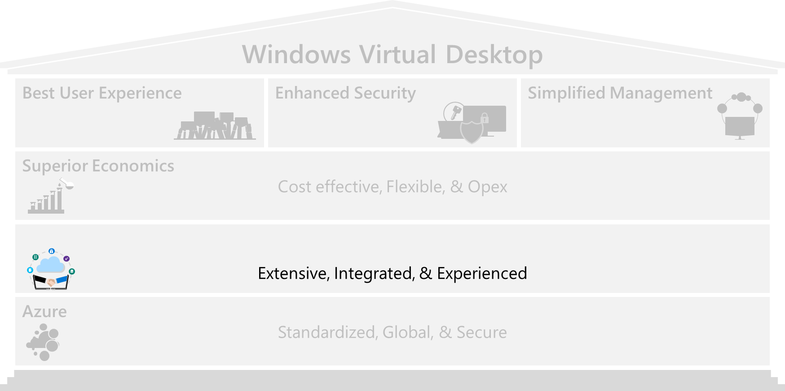


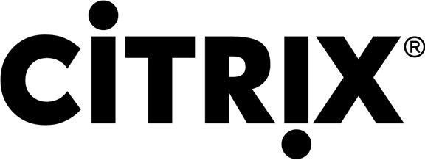





Extensive Partner Ecosystem with Strong Virtual Desktop Expertise
Strong Partner Ecosystem
WVD Approved Providers
WVD Value-Added Partners
Citrix and VMware provide value add to WVD (e.g. hybrid deployment management)
Windows 10 Enterprise multi-session is also available with Citrix & VMware management planes
Customer ultimately decides the management plane(s) of choice between WVD Native, WVD + Citrix Cloud and WVD + VMWare based on their business/technical needs
WVD customers have access to a broad SW/Services partner network with expertise in
Customer Environment Assessment
Diagnostics & End User Experience Monitoring
Application Layering
Management
Printing
App Compatibility Assessment / Remediation

Slide 5
Strong Expertise in Virtual Desktop Deployment and Management
Strong Partner Ecosystem
Category | Description | Partner Solution Examples |  | Delivery Mechanism
Customer Environment Assessment | Assess resource utilization of apps/users/OS, baseline user experiences and recommend sizing for WVD | Lakeside Liquidware ControlUp |  | Azure Marketplace
Diagnostics & End User Experience Monitoring | Assess, monitor, and manage end user experiences with GUI enabling reactive troubleshooting as well as predictive troubleshooting leveraging AI/ML | Lakeside Liquidware ControlUp | RDPSoft Sepago | Azure Marketplace
Application Layering | Enable dynamic provisioning of apps during boot/log on time based on user profile | Liquidware Citrix’s Unidesk |  | Azure Marketplace
Management | Deployment and configuration | Active Cypher CloudVae CloudJumper | Nerdio PTG Ubikite | Azure Marketplace
Printing | Remove the need for print server infrastructure | Uprint ThinPrint |  | Azure Marketplace
App Compat Assessment / Remediation | Assess app compatibility for layering new packaging | Cloudhouse Citrix’s Unidesk Numecent | Liquidware | Azure Marketplace

Slide 6
Lighthouse Program - Exclusive Offers 3-6 months of free ISV/Tool Licenses

Slide 7
Citrix Cloud for Lighthouse Pilot customers

Slide 8

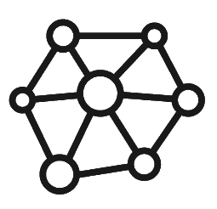








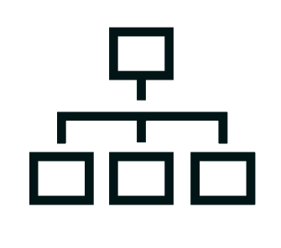
Lakeside (SysTrack)
Core Applications & Data
Important Workspace Features
Technology & Business Alignment
Continuous assessment
Groups of Users
Common Characteristics
Requirements & Needs
Devices
Workstyle
Comparative Analytics
End user endpoint
Central SysTrack collection
IT Administrator
A SysTrack agent is installed on the physical or virtual endpoint where it gathers & analyzes telemetry
Whether in cloud or on-premises, endpoint data is analyzed by the SysTrack database
The IT administrator monitors and leverages insights from SysTrack’s analysis in real time, proactively solving issues before they become problems
Notes:
Purpose of this slide
Discuss the value of Personas.
Storyline
Measurements
By using personas in your initiative, you can focus more on what to measure, and how to measure it. Personas created for a specific initiative may have this information contained within them. Not only does this provide all team members with a target, it also provides the item that will be measured to determine the value of the initiative.
Adoption rate
Because measurements have been given for the value expected, the team can track the rate of adoption of the solution after it is deployed. This provides the ability to see if the expected value will be realized.
Adjust plans
Because specific measurements have been given, and the rate of adoption is being tracked, adoption plans can be adjusted if the targeted expectations might not be met. In addition, a team may decide to change the items being measured. Because the focus is on a persona, it’s easier to do these things than if the focus was on the entire user population. In other words, by categorizing users into personas, very specific actions can be taken for very specific people.

Slide 9
Liquidware
Simplify App Management with dynamically attached app layers
Reduce image management overhead by eliminating native application installs
Enable applications to remain persistent in non-persistent desktop environment
Integrate seamlessly with existing App Lifecycle Management workflows
Speed adoption of WVD with seamless zero-downtime user migrations from any workspace platform
Selectively harvest user profiles and data for efficient, repeatable migrations to WVD
Hydrate FSLogix profile containers with select user profile data and access to user-authored data
Enable backup / fast restoration of FSLogix profiles, complementing FSLogix Cloud Cache

Slide 10


Why Cloud Workspace Management Suite?
Orchestration and Automation for WVD
Deploy
Provisions WVD and RDS to multiple environments
Interfaces with cloud and hypervisor components
Manage
User, Application, Data Layer Functions
Resource matching with VM scaling and workload scheduling
Integrate
Full REST API for incorporation in large orchestration environments and admin operations
Notes:
CloudJumper takes the base MS components and does three key things:
Provisioning
Deploy RDS to multiple environments - started in the vSphere world, moved to supporting Azure, AWS, and GCP.
Provide a layer of abstraction - IT admin support EUC deployments do not need to know about the hypervisors and clouds, just that the VMs will be there
Provide the session layer - IT doesn't have to worry about repeated provisioning and sizing of those components
Much more time-consuming process w/o CJ and at the component level
Management
After env is up and running CJ provides day-to-day operational management
Resource matching - balancing between allocating resources not being used with making sure the virtual env is on par with physical devices on the desktop
Helping IT admins manage user env by:
Setting user permissions and controls
Install and updating user apps
Virtual desktop environments can be centrally managed from our cloud control plane irrespective of where they are located
Integration
In the EUC world
Tools examples include: RightScale, Terraform, ServiceNow, Workday - all of those tools drive provisioning and change mgmt actions from end-users requesting it - HR person with new employees needing a new desktop, maybe existing workspace env can be enhanced (more resources, permissions changed, more apps)
We fit into a bigger world of what's becoming an automated service architecture - if there's a component of the EUC solution that needs to change, then you can call it from the REST API that does not require our web UI to do it

Slide 11

Nerdio
Azure Migrate
Assess
Price
Deploy
Extend
Migrate
Optimize
Manage
Invoice
Inventory existing environment
Estimate the cost of Azure deployment
Build Azure environment for workloads to “land”
Connect Azure deployment to existing environment
Move “bits”
from existing environment
to Azure
Auto-scale VMs to save on costs
Operationally manage all aspects of
new Azure environment
Invoice customers for Azure consumption
And managed services
Examples of WVD enhancements
SIMPLE DEPLOYMENT
EVENT-BASED AUTO-SCALING
PRICING AUTOMATION
AUTOMATED HOST POOL CREATION
HOST POOL IMAGE MANAGEMENT
SAFE PILOT
AND POC

Slide 12
THANK YOU
WVD Presentations and Recordings will be available to Partners and Microsoft internal resources post GA

